Slide 1
Capstone Project Land Prices & Venues Data Analysis of Tokyo Metropolis
Hideshi Yoshinaga

Slide 2
Table of Contents
Introduction: Business Problem
Data
Methodology
Results
Discussion
Conclusion
References

Slide 3
Introduction: Business Problem
Center of business, culture and politics - Tokyo Metropolis
Over 13 million people (23 wards rural cities and islands).
Huge number of living people and a lot of visitors at 23 wards.
To find out candidates of the best location to start a restaurant or to open an office for business
We will need to consider what kind of venues are available in Tokyo Metropolis for analyzing competition.
We will also need to choose appropriate area which has reasonable rental price of venues.
To focus on 23 wards (central area) of Tokyo Metropolis with subway station map and land price map
The center of business, politics and all the cultural activities with more than 9 million people.
I would like to study venue information around major subway stations which are located in major area of 23 wards. Distance from station is essential to start new business in central Tokyo.
I would also like to show major venue category around subway station and land price of 23 wards.

Slide 4
Data
In order to consider the problem, we will use the data as below:
Tokyo Metropolitan Government (Ref 1)
Land price information from Tokyo Metropolitan Government, Bureau of Finance (2018).
This land price will be reflected to rental price of office or restaurant and it will be the major part of the cost of new business. (Ref 2)
Tokyo subway map and location information.
Subway map by Tokyo Metro (subway management office) (Ref3)
Geocoordinates for subway stations. (Ref 4)
Geojson data for Tokyo Metropolis
23 ward parts was used to create choropleth map of average land price for each of 23 wards from the land price information (Ref 5)
Venue information by Foursquare API
To find our appropriate places to open a restaurant or an office, I used Foursquare API to find venues around major subway stations which are located in major part of Tokyo Metropolis 23 wards. (Ref 6)

Slide 5
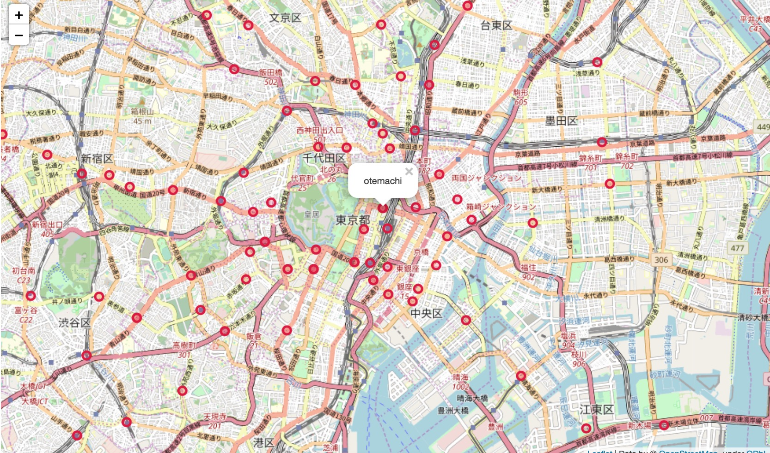
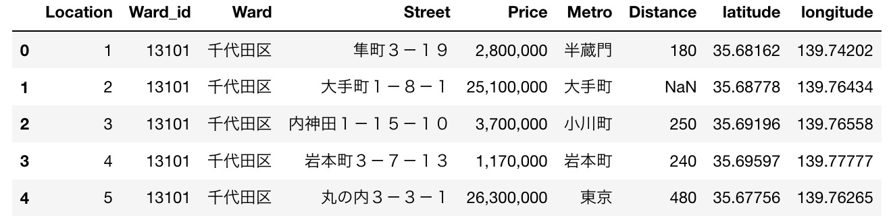
Methodology (1)
Used python folium library to visualize geographic details of Tokyo Metropolis and its 23 wards.
I selected 5 major subway lines (marunouchi, chiyoda, hanzomon, hibiya, yurakucho) which have total 104 stations.
Used land price data from Tokyo Metropolitan Government, Bureau of Finance (2018).
The data consists of ward, address (street), price (yen/m2), subway name, distance to the subway station, latitude, longitude. (total 678 locations for 23 wards)

Slide 6
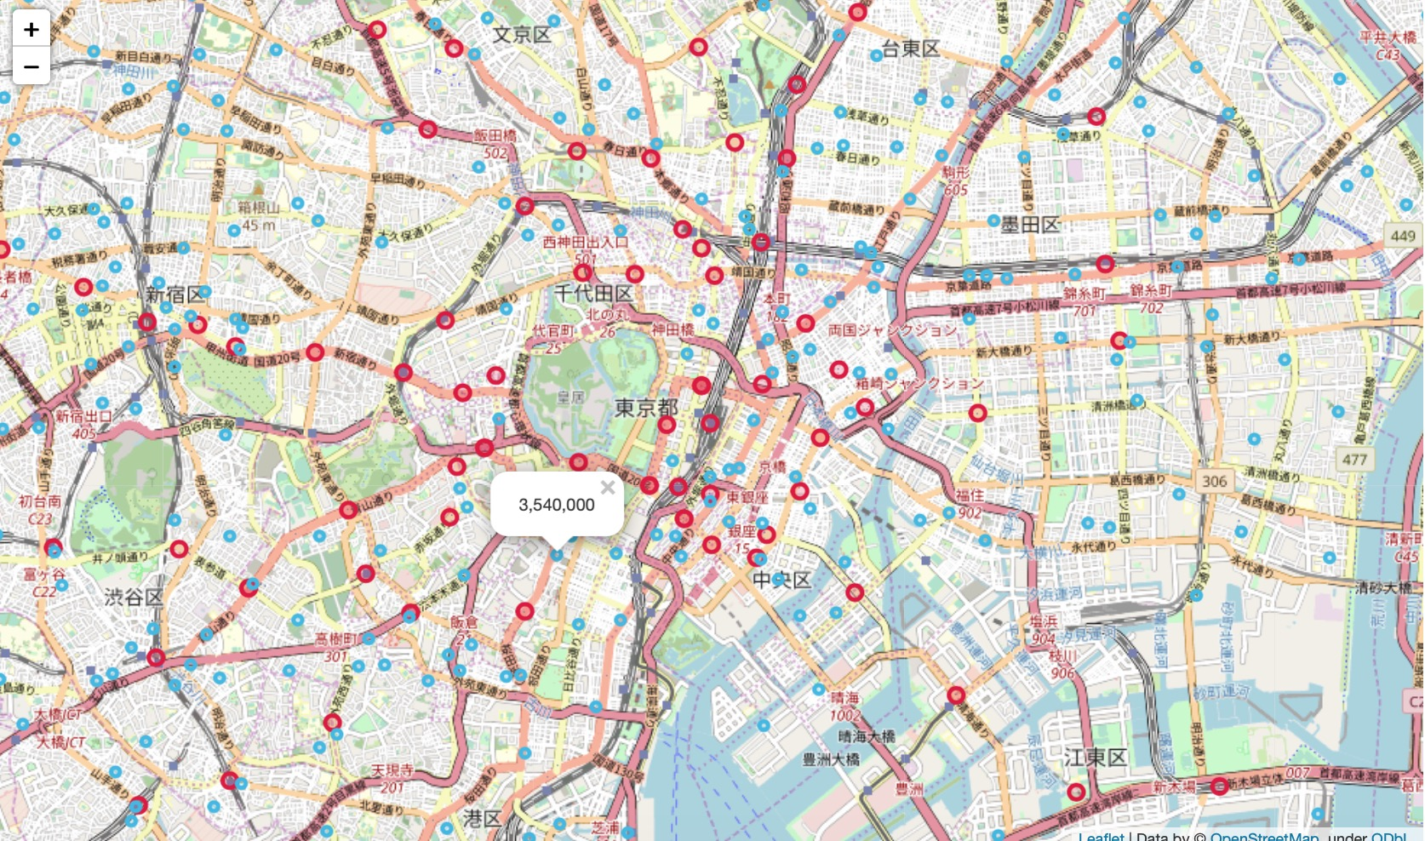
Methodology (2)
Combined two maps.
Land price information ( yen for per square meter) and its locations.
Blue - total 678 locations for 23 wards
This example shows 3,540,000 yen/m2, which is about $33K/m2.
Subway stations in 5 lines
Red – total 104 stations of chiyoda, hanzomon, hibiya, yurakucho, marunouchi

Slide 7
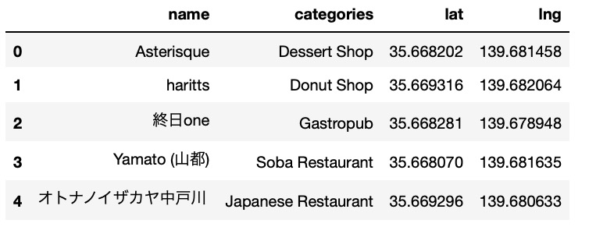
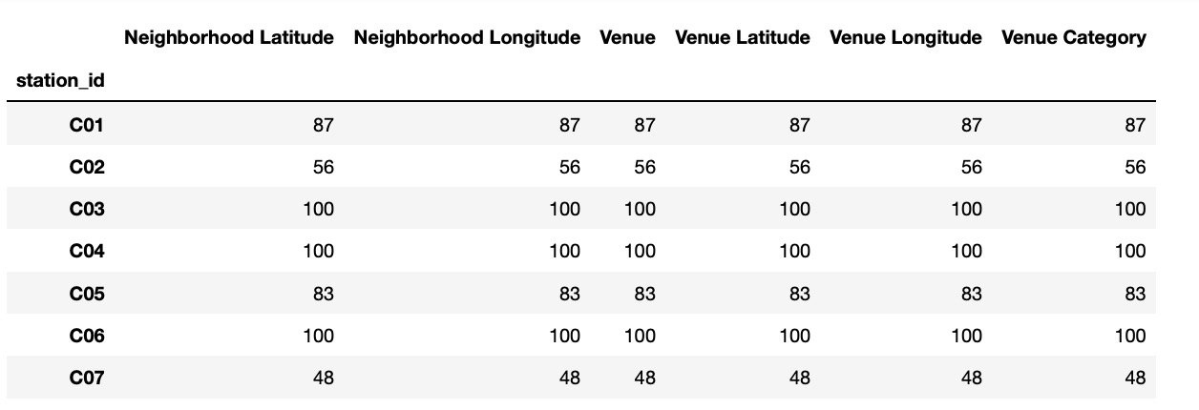
Methodology (3)
Utilized the Foursquare API to explore the subway stations and its neighborhood.
Designed the limit as 100 venues and the radius 500 meters for each subway station from their given latitude and longitude information.
This example is shows venues around Chiyoda-line C01 (yoyogi-uehara station at 35.669066, 139.67968)
Consolidated all the venues for 104 stations.
C01, C02, C03 are showing stations of Chiyoda-lien and total venues are 87, 56, 100 (max) for example.

Slide 8
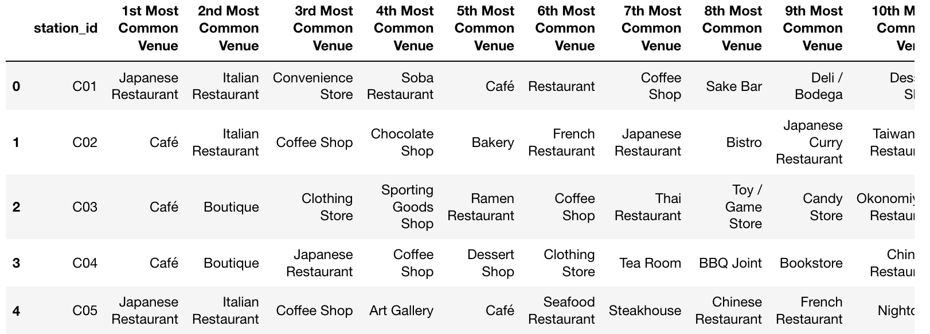
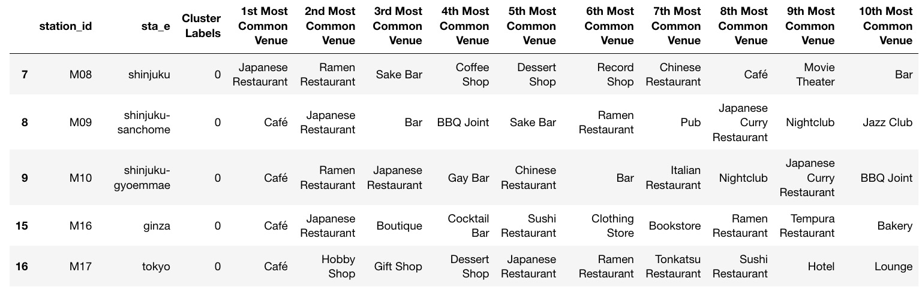
Methodology (4)
Found 7721venues and 308 unique categories for 104 stations with Foursquare API.
I created a table which shows list of top 10 venue category for each subway station in below table.
Used unsupervised learning K-means algorithm to cluster the 104 stations. K-Means algorithm is one of the most common cluster method of unsupervised learning.
At this report, I used K as 5 for clustering. The following is top part of cluster - 0.
The most common venues for each cluster are as follows.
Cluster 0: Café, Japanese Restaurant, Hotel, Italian Restaurant
Cluster 1: Sake Bar, Café, Convenience Store
Cluster 2: Convenience Store, Ramen Restaurant, Park, Hotel
Cluster 3: Convenience Store, Japanese Restaurant
Cluster 4: Japanese restaurant, Ramen Restaurant

Slide 9
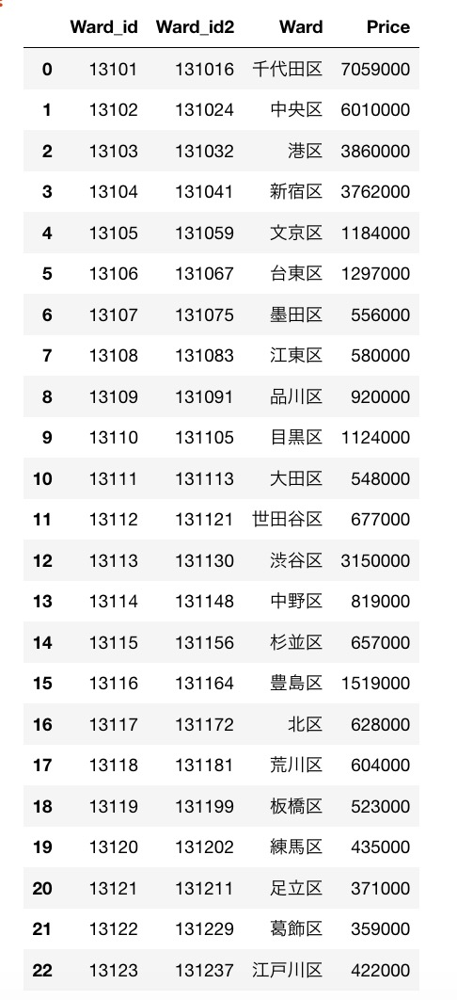
Methodology (5)
Summarize land price of 23 ward.
Based on land price map, I summarized average land price for 1 m2 (for per square meter) for each ward. These averages were made from total 678 locations for 23 wards. (ward_id2 is geojson id.).
Average land price for 23 wards varies according to the distance from central Tokyo (Tokyo Station) and at the same time, we understand land prices vary according to the distance to nearby subway station in each ward.
Categorized to these 23 wards into four groups.
5,900,000 < 千代田区(Chiyoda), 中央区(Chyuo)
3,700,000 < 港区(Minato), 新宿区(Shinjuku)
1,500,000 < 渋谷区(Shibuya), 豊島区(Toshima)
350, 000 < Other wards

Slide 10
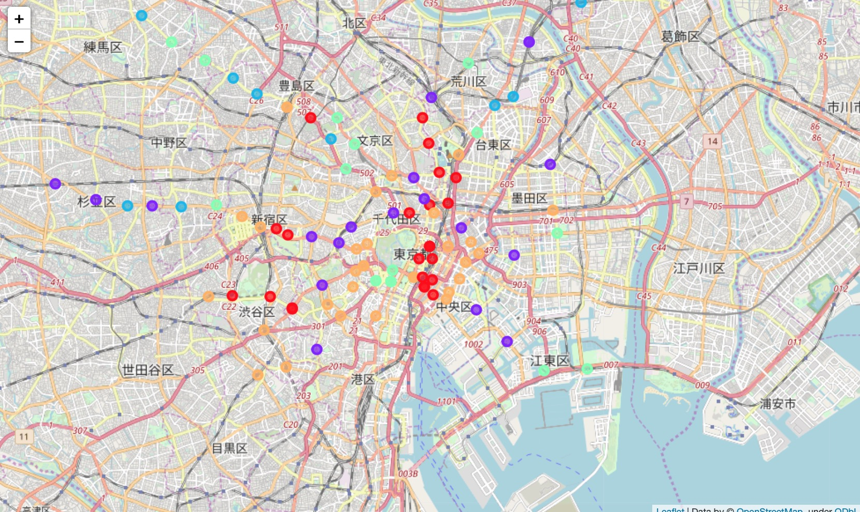
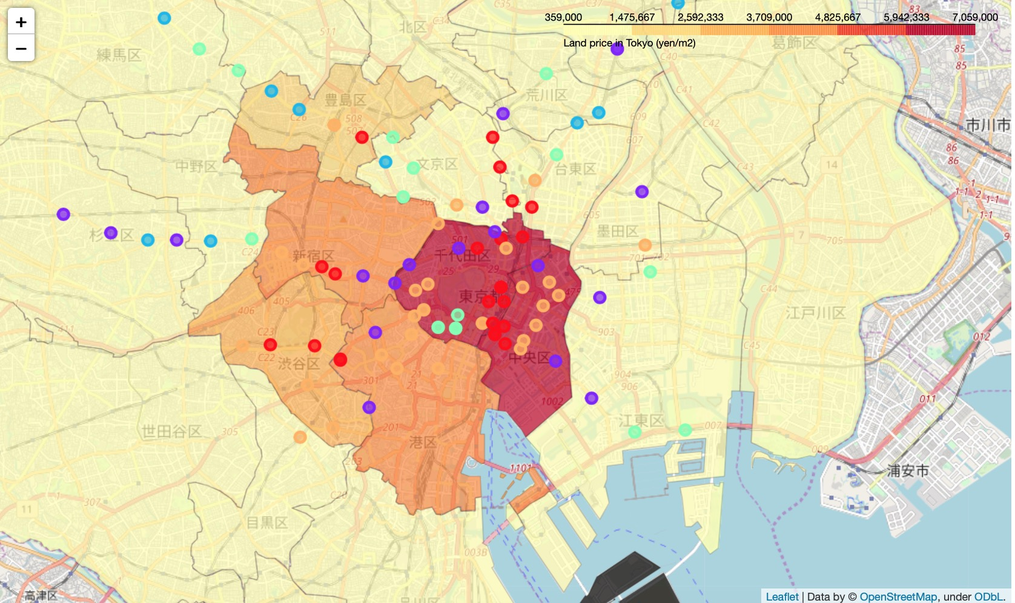
Results
Subway station map with related cluster information. This map has 104 stations with 5 cluster information. (we will have details of 5 clusters at Appendix.)
Choropleth map which has average land price for per square mete and the below information for each subway station:
Station id
Cluster name
Land price information.

Slide 11
Discussion
Broader subway station coverage :
As Tokyo has 12 subways, we may use another combination of subway lines to expand our city coverage.
Population or dynamics of population :
For opening new restaurant or for opening new office, we may also consider population or dynamics of population change in a day.
K-means and size of clusters :
I used 5 clusters at this study, however we may change the number of K according to type of venues/business.
We can also apply other clustering methods or classification methods.
More fine grained land price map :
We may use more fine grained land price map not by ward but by smaller city or town level unit.

Slide 12
Conclusion
Initial step to find appropriate spot for opening a restaurant or opening a new office.
Our approach will show us the initial options which we can take for achieving the goal such as to start new restaurant or to start new office – low cost, more populated area, and distance to the major transportation.
Dramatic improvement of telecommunication technology, of transportation, or of new type of services such as delivery services.
As next step, we will also need to consider access for new advantages and/or access to new platform where we can get such new services.

Slide 13
References
Tokyo Metropolitan Government ( http://www.metro.tokyo.jp/english/ )
Land price information from Tokyo Metropolitan Government, Bureau of Finance (2018). ( http://www.zaimu.metro.tokyo.jp/kijunchi/30nen/index.html ).
Tokyo subway map ( https://www.tokyometro.jp/en/subwaymap/ )
Tokyo subway geo coordinate ( https://www.javadrive.jp/google-maps-javascript/data/index2.html )
Geojson data for Tokyo ( https://github.com/dataofjapan/land/blob/master/tokyo.geojson )
Foursquare API ( https://foursquare.com/ )

